Slide 1
A Call to Action
Jerry’s Ford Leesburg
Providing Recreational Activities to Boost Mental Resiliency in First Responders

Slide 2
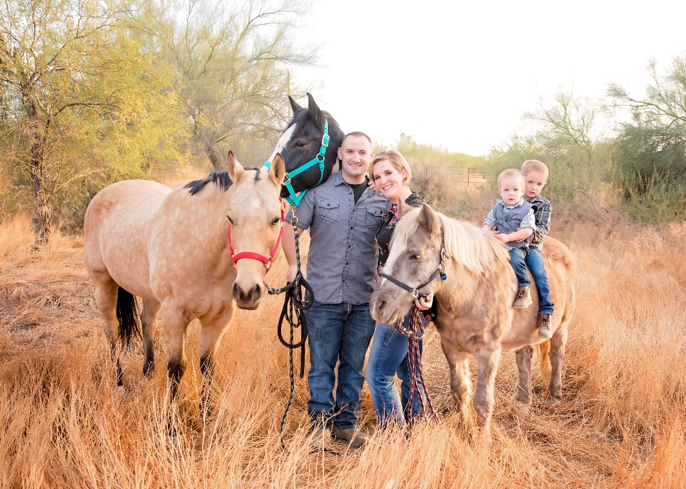
About your Presenter
Saebra Pipoly
Lifetime with horses
15 years teaching ‘traditional’ equine lessons
10 years teaching ‘adaptive’ equine lessons
Multiple certifications in the EAAT & equine industry
Incoming PATH Intl. Region 10 Representative

Slide 3
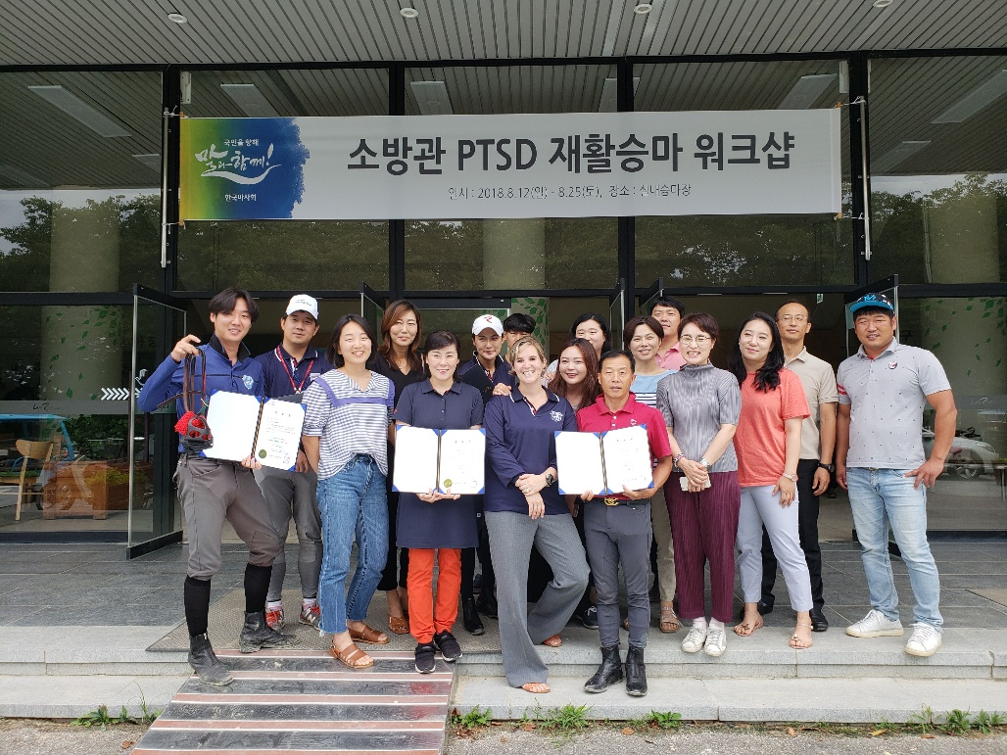
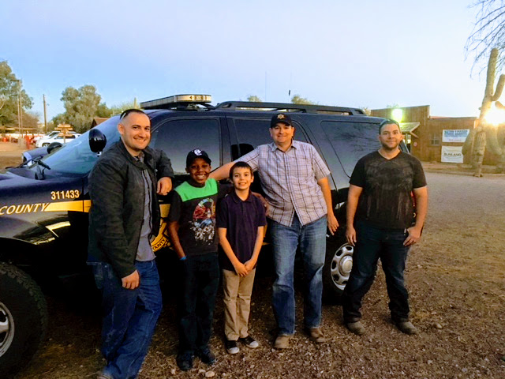
An ‘Aha moment’
South Korea
Building an recreational equine program for Korean firefighters
Youth & Officer Mentor program in early 2018
2 equine programs nationally
1 bike rebuilder program here in AZ
A lot of military and veteran geared programs
What about first responders???
Increasing suicide and mental health issues in first responders

Slide 4
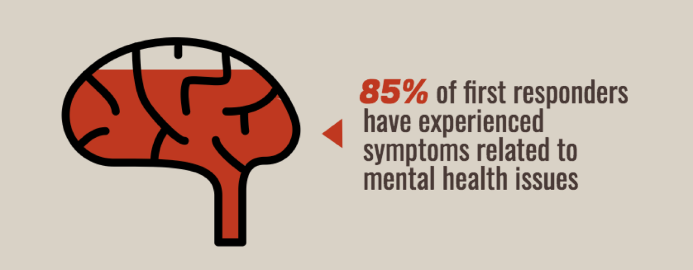
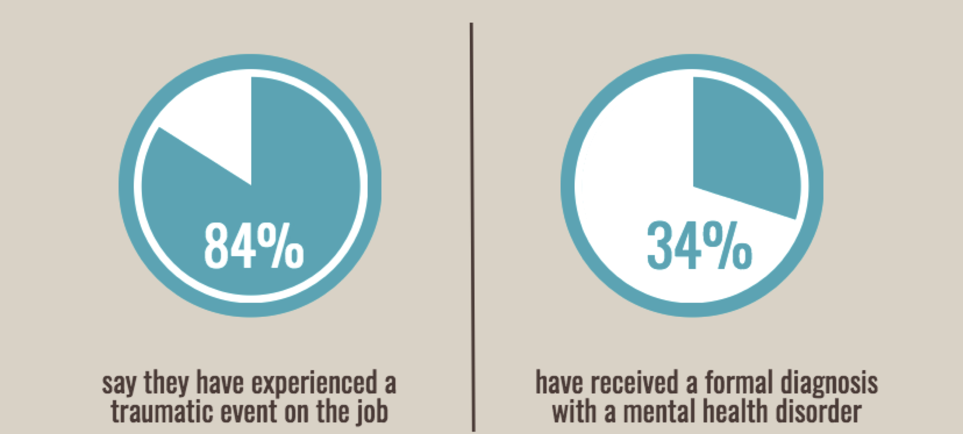
What is the “Call to Action”?
Help first responders to maintain active, healthy lives outside of their jobs and mental resiliency, overall.
First Responders are at a higher risk for not only mental health related issues but also physical ailments
Shift work, stress, poor diet, poor sleep, critical incidents
First Responders experience ‘critical events’ at a much higher rate than the average population
When looking at firefighters and police- high priority put on preventing physical injury and staying physically trained….but what about mental preparedness and injury?
Study by University of Phoenix, April 2018

Slide 5
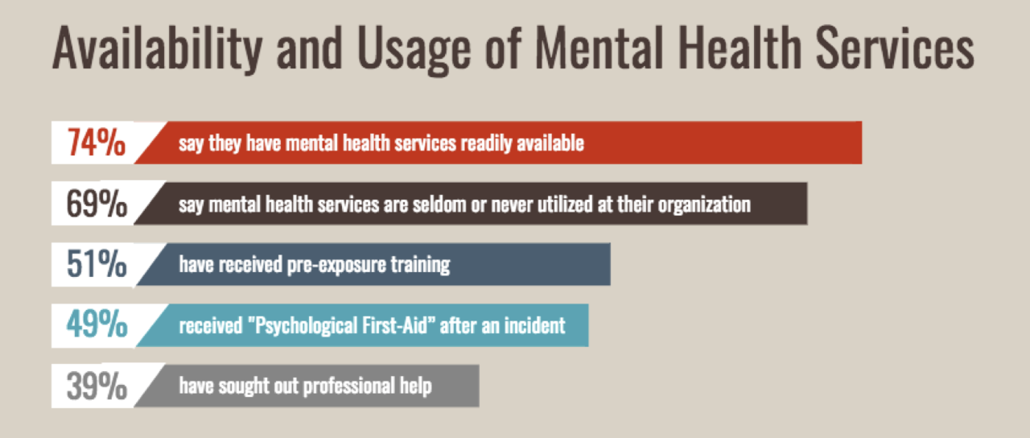
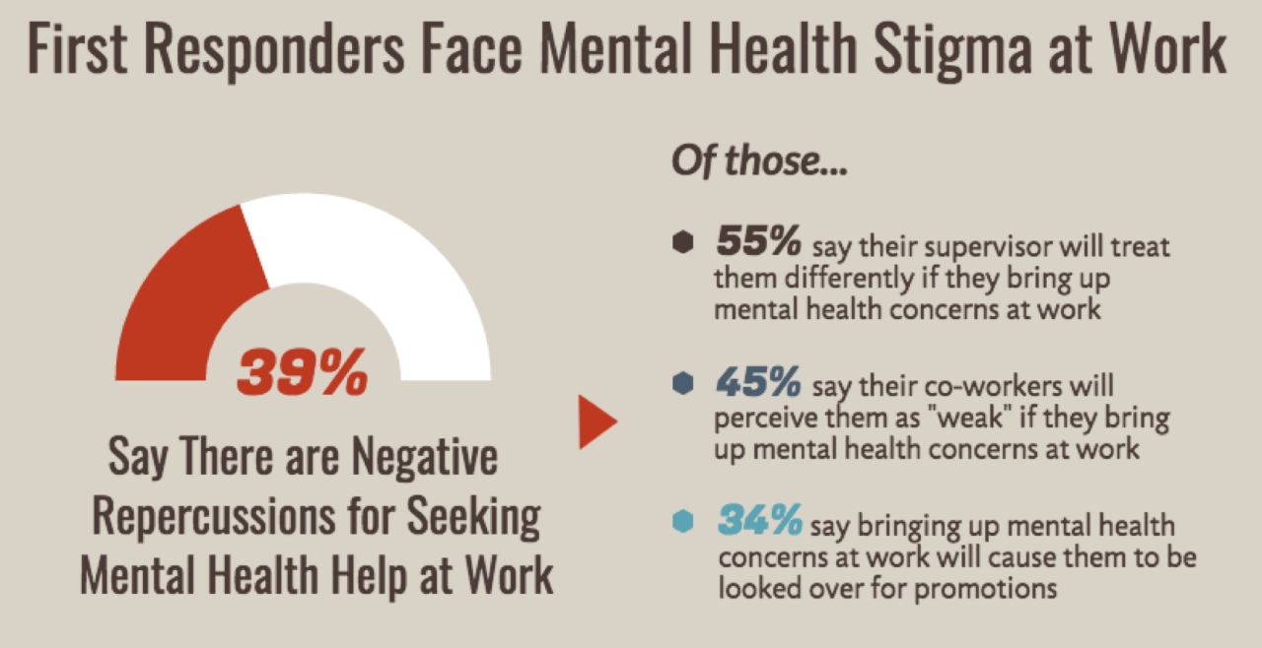
What is the “Call to Action”?
Mental health support is ‘there’ but under utilized
Reactive vs. proactive
Should be we be offering recreational activates or mental health support?
Both!
Examples of activities to follow
Help build and maintain resiliency
Ability to adapt well to stress adversity, trauma, tragedy
Can be learned
How can recreational outlets help our first responders?
Study by University of Phoenix, April 2018

Slide 6
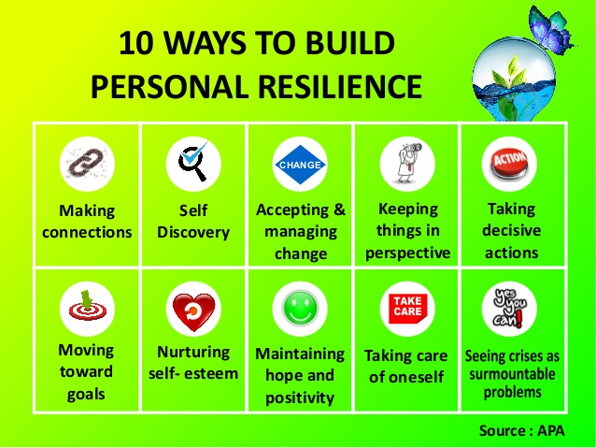
Building and Maintaining Resiliency

Slide 7
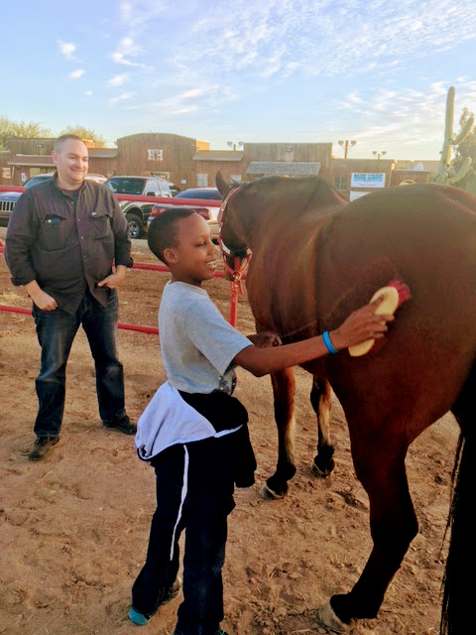
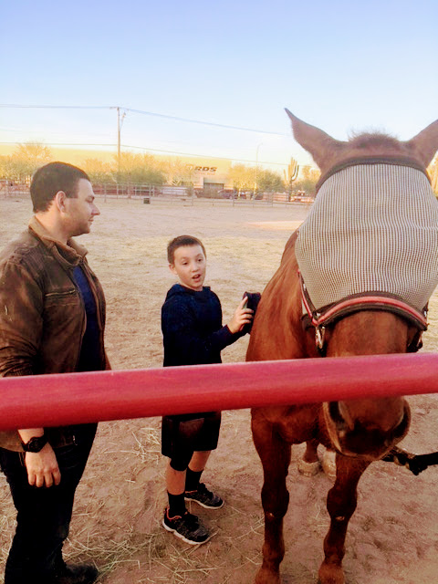
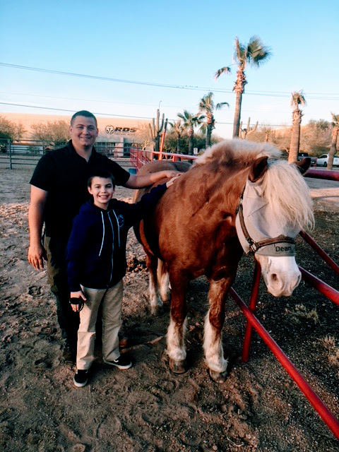
Example of Recreational Activity
Youth & Officer Mentoring Program…with horses!
Positively impacted officers:
Made connections
Self discovery
Building self-esteem
Moving towards goals
Maintain hope & positivity

Slide 9
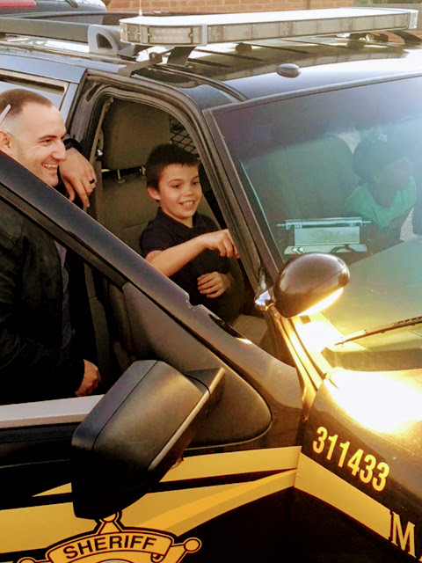
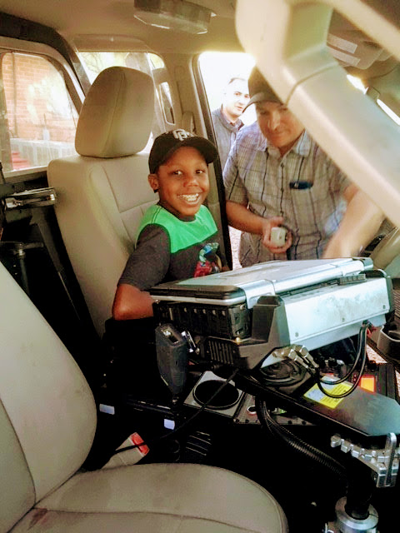
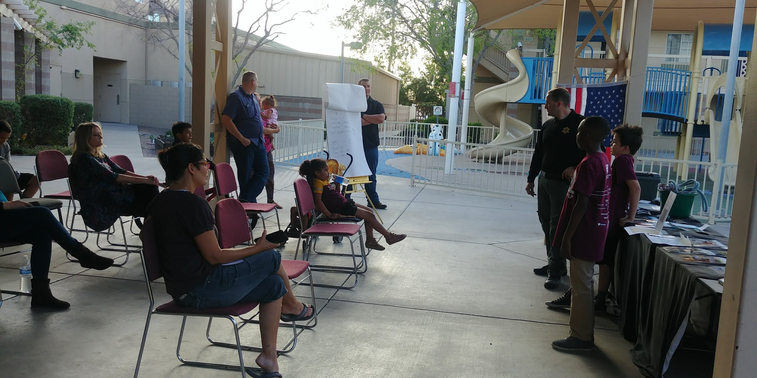
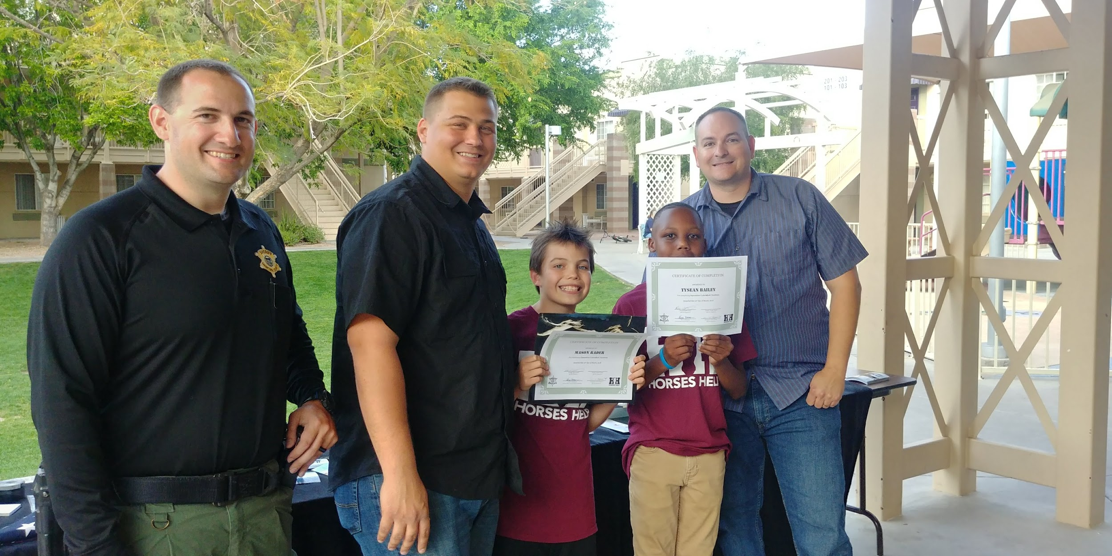
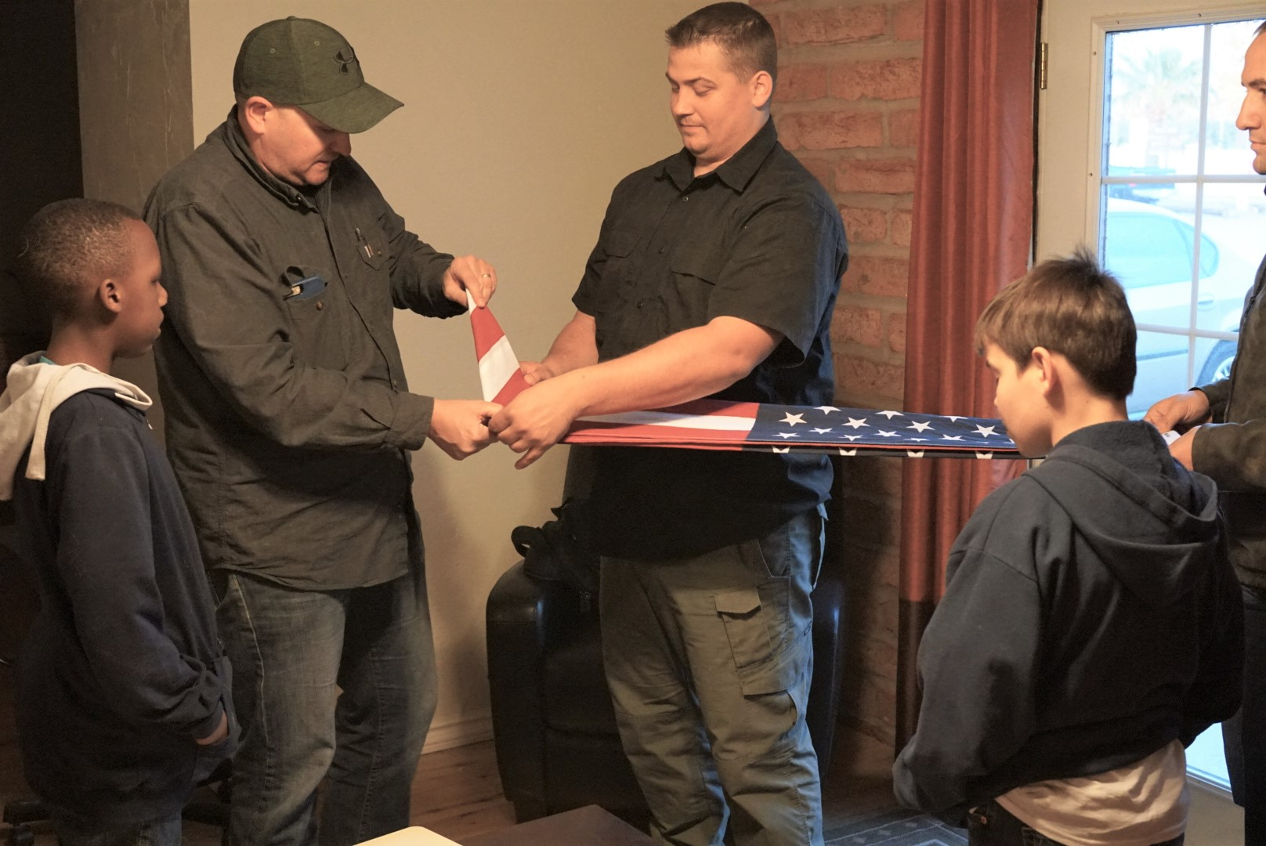

Slide 10
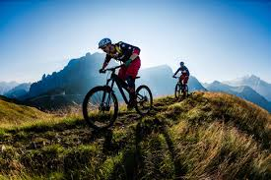
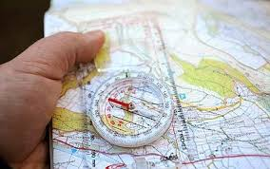
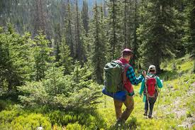
You have an idea….now what?
What type of recreational activity do you want to offer?
Partner with other organizations
Local barn
Local youth organization
Local fire or police department
Become familiar with the population you want to serve
Are you prepared to work with first responders?
Are you prepared to work with youth?
Set a high level of quality and safety
Don’t cross the line into ‘therapy’

