Slide 1
Wild Horse Management on National Forest Lands
United States Department of Agriculture
Tolani Francisco, DVM MPH
Wild Horse and Burro Coordinator
USFS, Southwestern Region
Albuquerque, NM
Forest Service
Southwestern Region
Notes:
I added the USDA and FS required icons for presentations. Also it is the Southwestern Region. Is this presentation really addressing gaps or challenges? It seems like it is really addressing challenges. Then after I typed the suggested title I read Sam’s invitation. He uses the word challenges, not gaps.

Slide 2
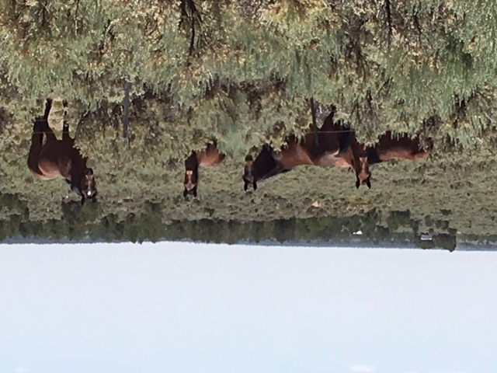
Overview
United States Department of Agriculture
Terminology
Environmental Concerns
Management Considerations
Education
Disposition
Thinking “Out of the Box”
Photo: Kaibab NF, AZ

Slide 3
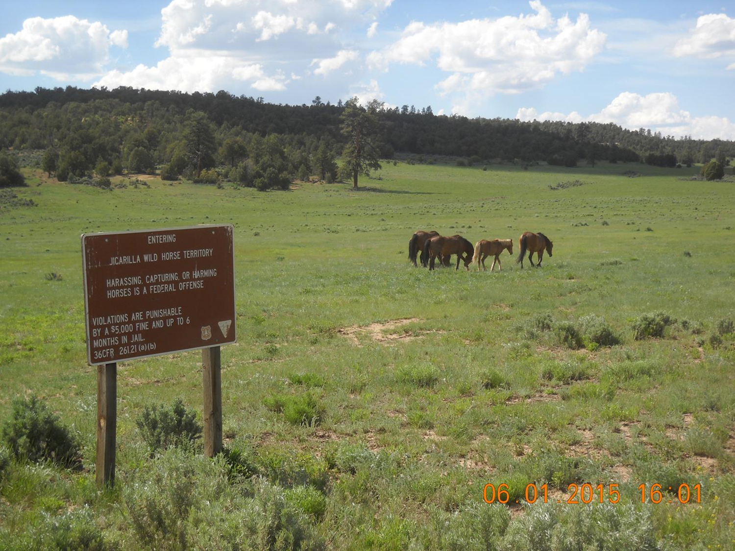
Terminology
United States Department of Agriculture
Wild
1971 Wild Free-Roaming Horses and Burros Act
Mustang
Feral
Free Ranging
Unowned
Special Status
Non-domesticated
Photo: Jicarilla WHT, Carson NF, NM

Slide 4
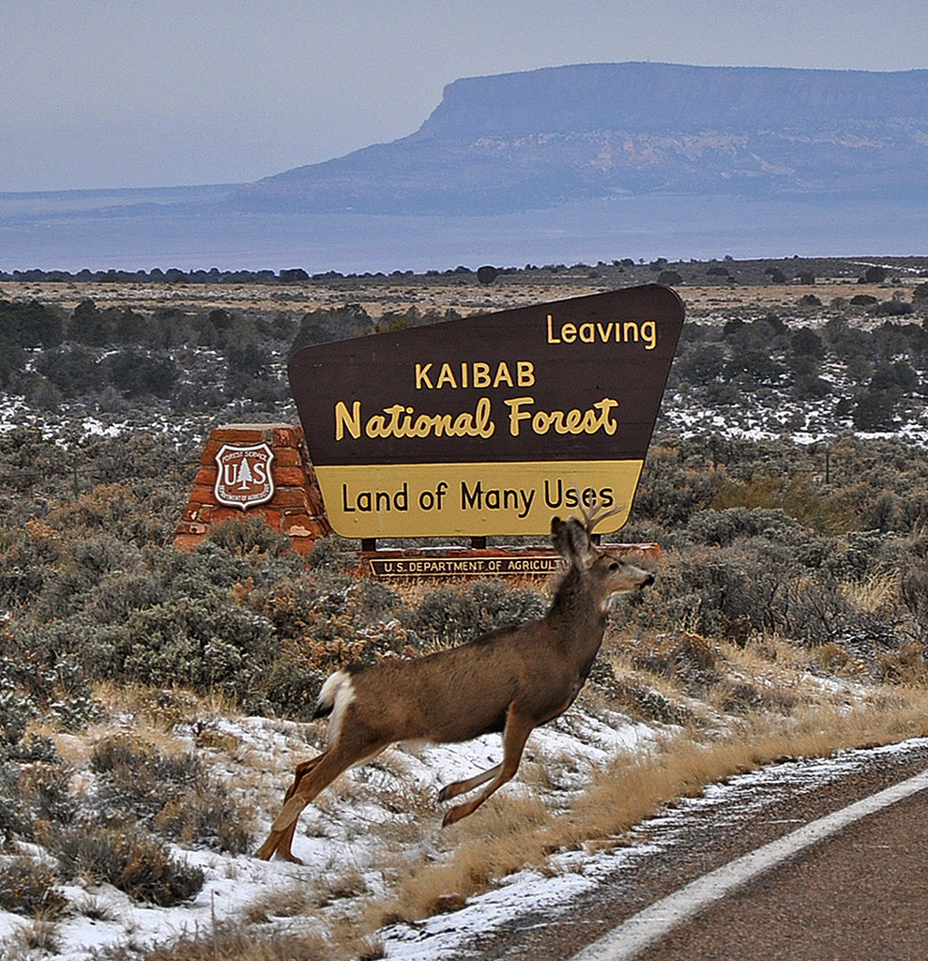
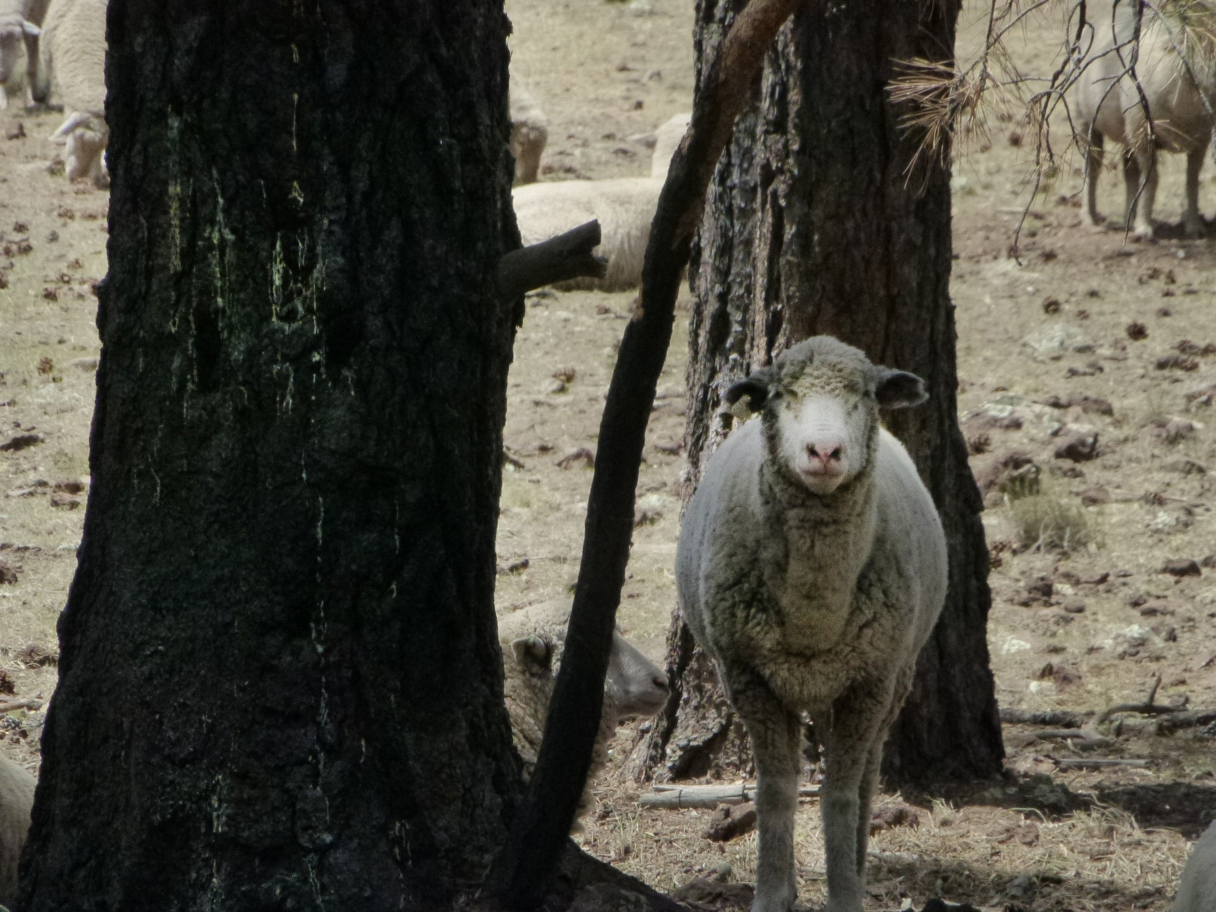
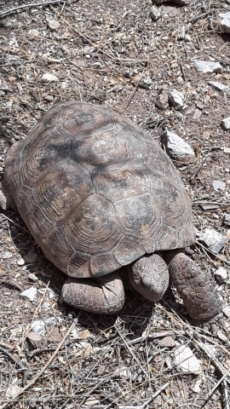
United States Department of Agriculture
Considerations within
A Multiple-Use Framework
Vegetation & Soils
Water
Wildlife
Public Health
Photos Courtesy Kaibab & Tonto NFs, AZ

Slide 5
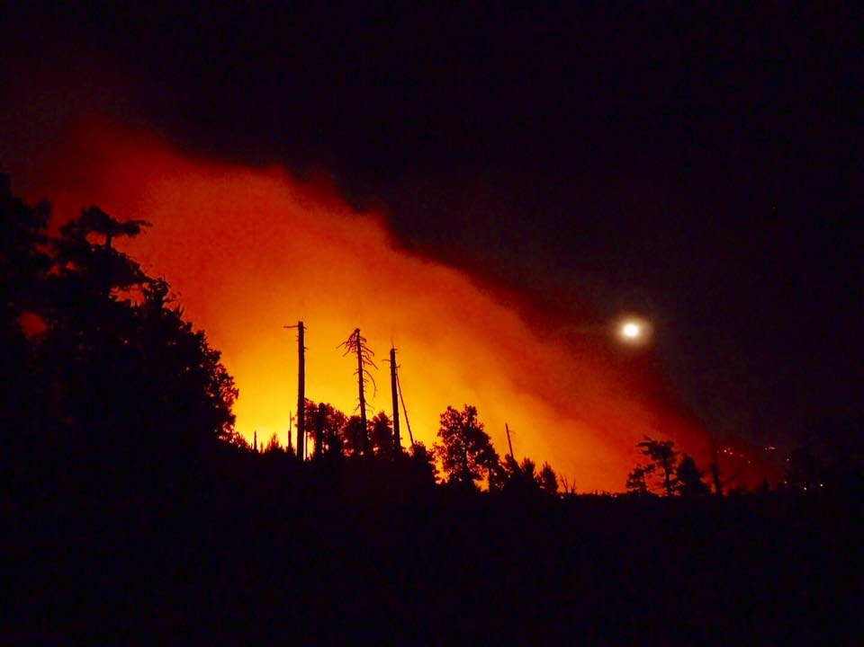
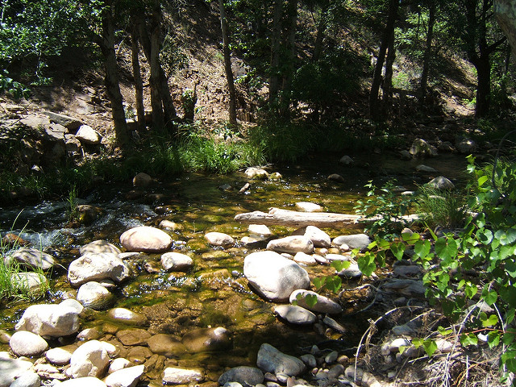
Environmental Concerns
United States Department of Agriculture
Water
Forage Availability
Fire
Photos courtesy Kaibab, A-S, & Tonto NFs, AZ

Slide 6
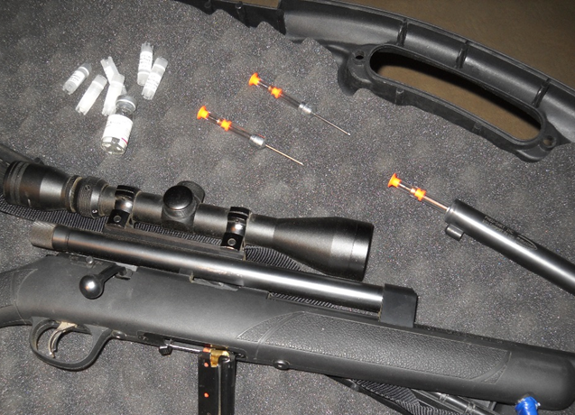
Management Considerations
United States Department of Agriculture
Appropriate Management Level
Genetic viability
Fertility Reduction
Native PZP (Zona Stat H)
PZP 22
Gonacon
Males vs Females
Surgical Sterilization
Chemical Sterilization
Photo: FS PZP Darting device & equipment

Slide 7
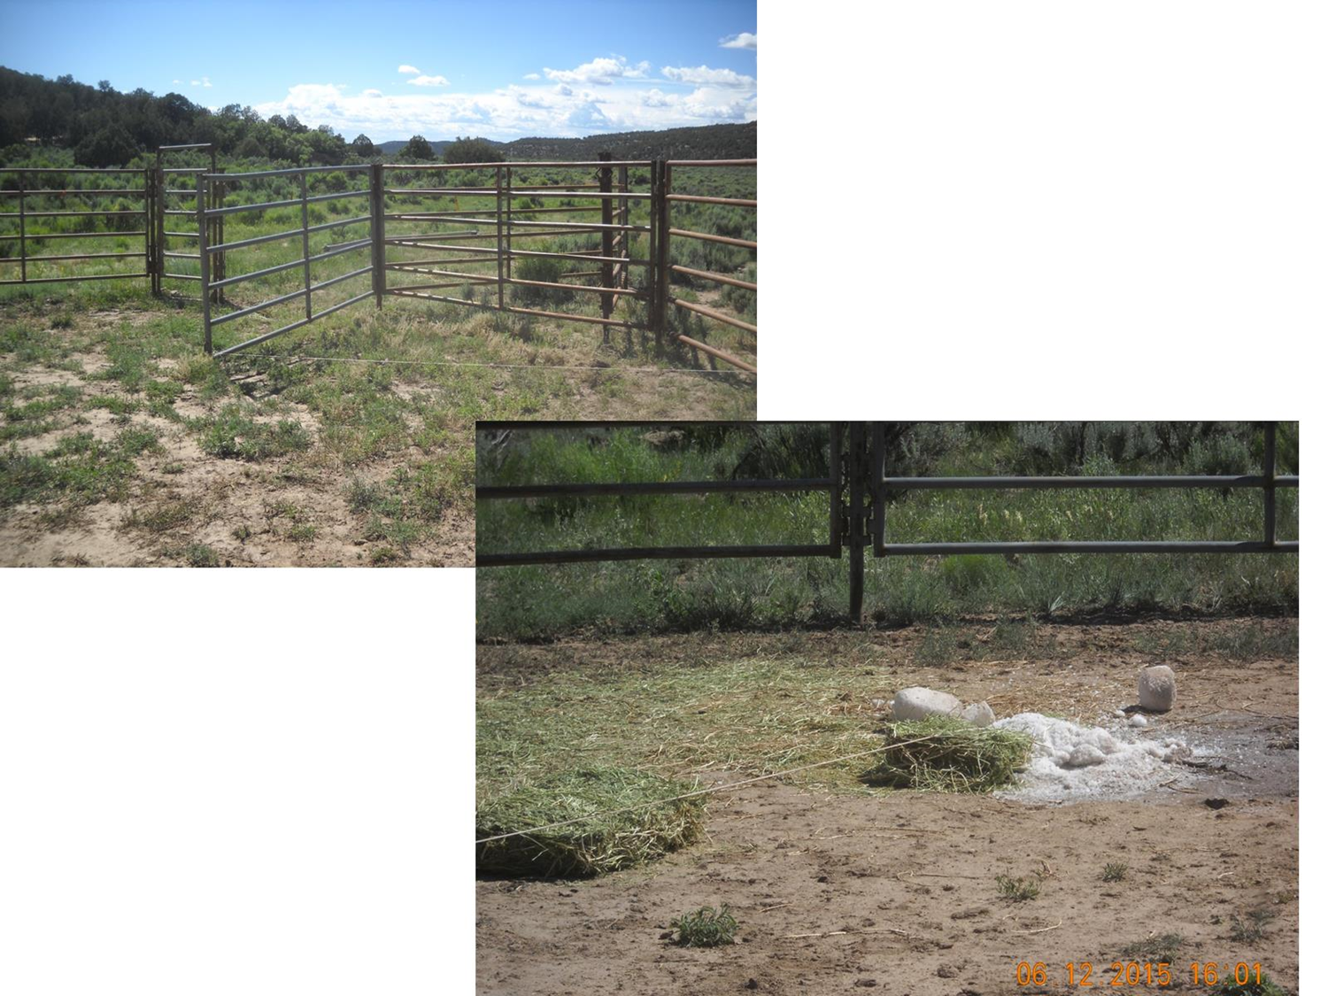
Herd Reduction Methods
United States Department of Agriculture
Long Term
Fertility Reduction
Short Term
Gathers
Low Stress techniques
Bait Trapping
Gentle gathering
More Traditional
Helicopters
Drones
Photo: S. Kelly, USFS
Notes:
Drone operators must meet FAA certification process.

Slide 8
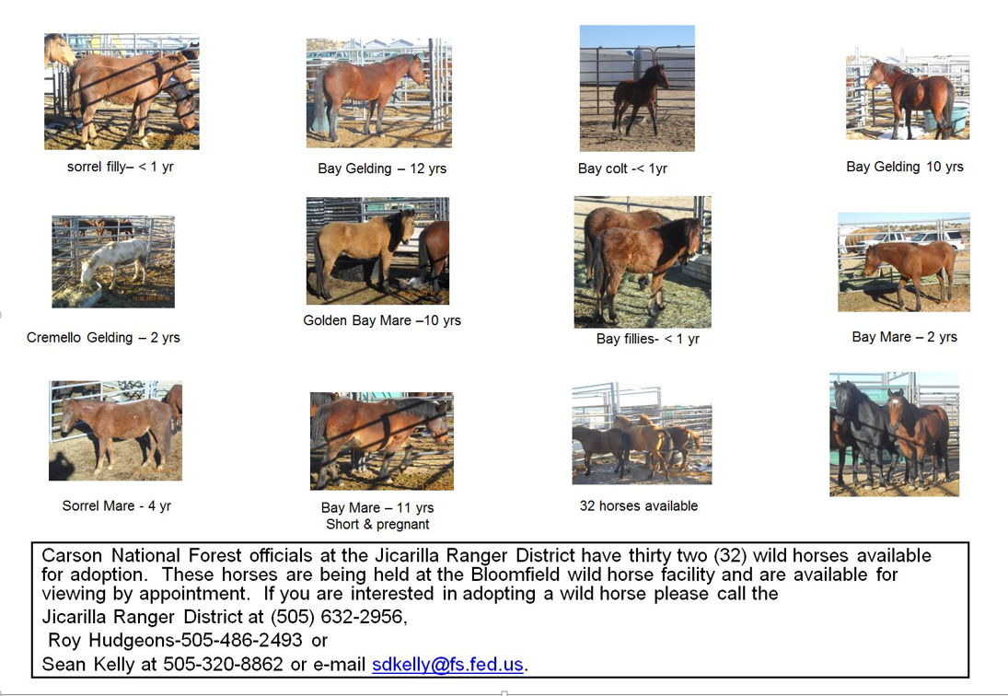
United States Department of Agriculture
Adoptions and Sales
Adoption
Application
Inspection
1 yr to title
Sale
Without limitation
Screen buyers

Slide 9
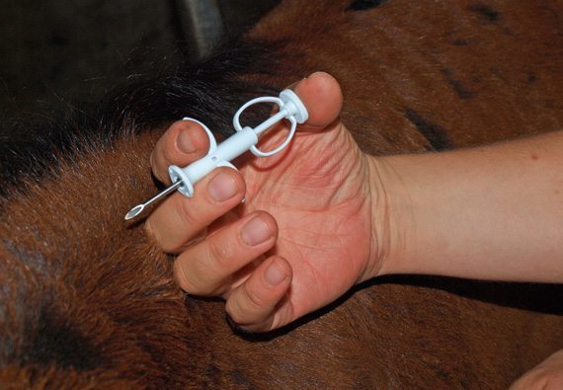
Identification
United States Department of Agriculture
Physical Descriptions
Photos
Drawings
Freeze Brands
BLM
FS
Microchips
Southwest Region
Registered in National database
Neck Tags
Not USDA compliant

Slide 10
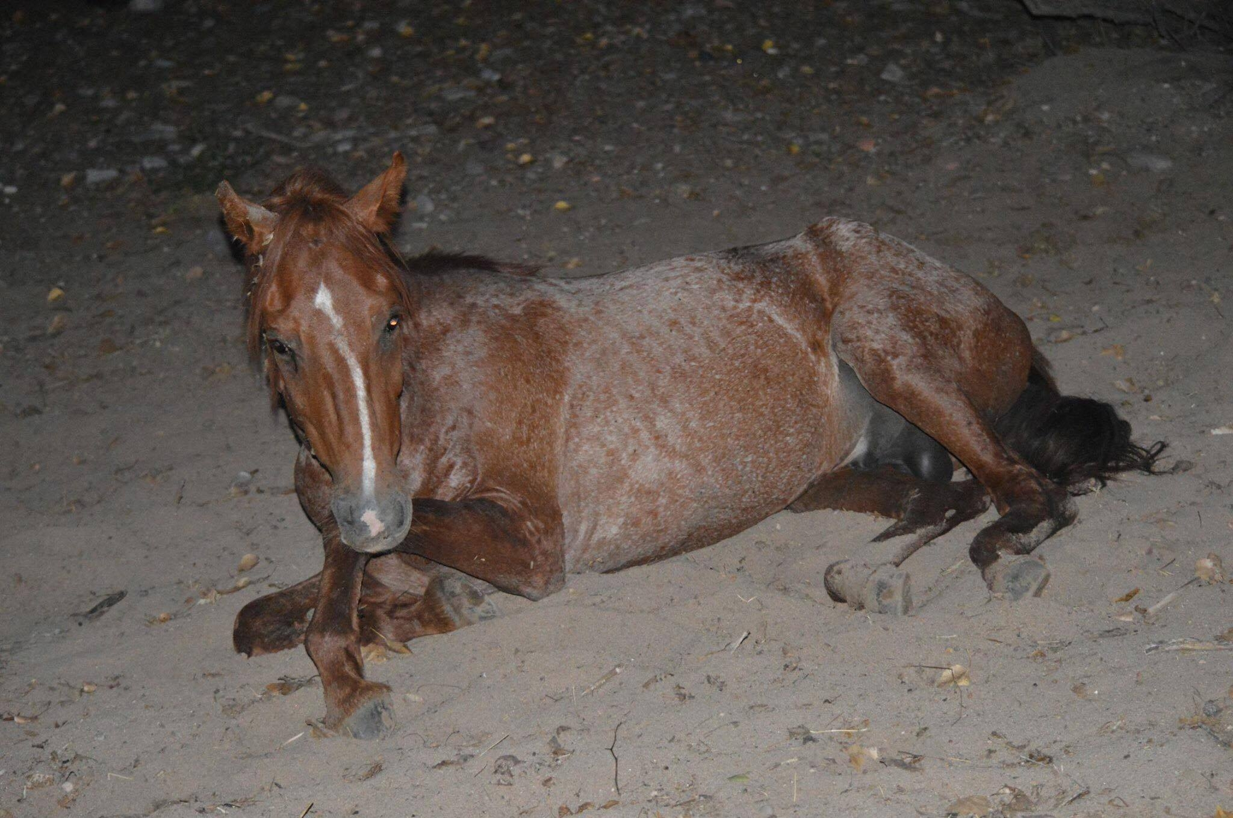
Education
United States Department of Agriculture
General Public
Advocates
Owners
New
Previous
Responsibilities
Health
Nutrition
Public Health
Photo: Courtesy AZDA

Slide 11
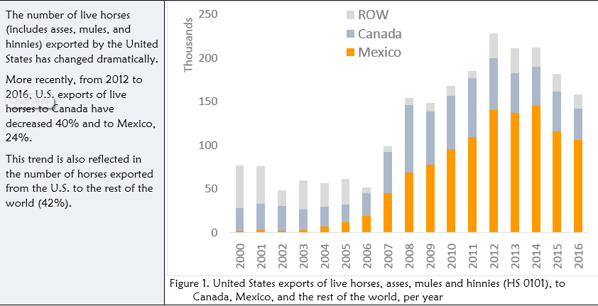
Dispositions
United States Department of Agriculture
US halted slaughter in 2007
Canada
6 month residence (EU requirement)
Reports indicate 65-70% from US
Mexico
In 2015, 87% of slaughter was from US
EU banned import of horsemeat Dec 2014
Concerns over pharmaceutical residues
Barbiturates in Dog Food (FDA)
EU & Asian for human consumption
Carcass Disposal
Source: USDA APHIS VS, CEAH May 4, 2017, North American Live Horse and Global Horse Meat Trade Trends

Slide 12
Time to think outside the Box
United States Department of Agriculture
Mark Zabel PhD- CSU Zabel Prion Laboratory
William E. Simpson-horse talk blog
https://www.horsetalk.co.nz/2017/07/20/politicization-plight-wild-horses-burros-america/#FzUp8MzMhwPMSlVv.99
Collaboration between agencies, tribes, states, universities, NGO’s
Tribes have more horses than the BLM
Perryman et al, Range Magazine
Forum: A Framework for Resetting Wild Horse and Burro Management
No single answer-together we MUST do more

Slide 13
Questions?
United States Department of Agriculture
Tolani Francisco DVM MPH
Wild Horse and Burro Coordinator
USFS Southwestern Region
333 Broadway Blvd, SE
Albuquerque, NM 87102
tolanifrancisco@fs.fed.us
Desk 505-842-3260
Cell 505-850-3253
Photo: Heber horses

