Slide 1
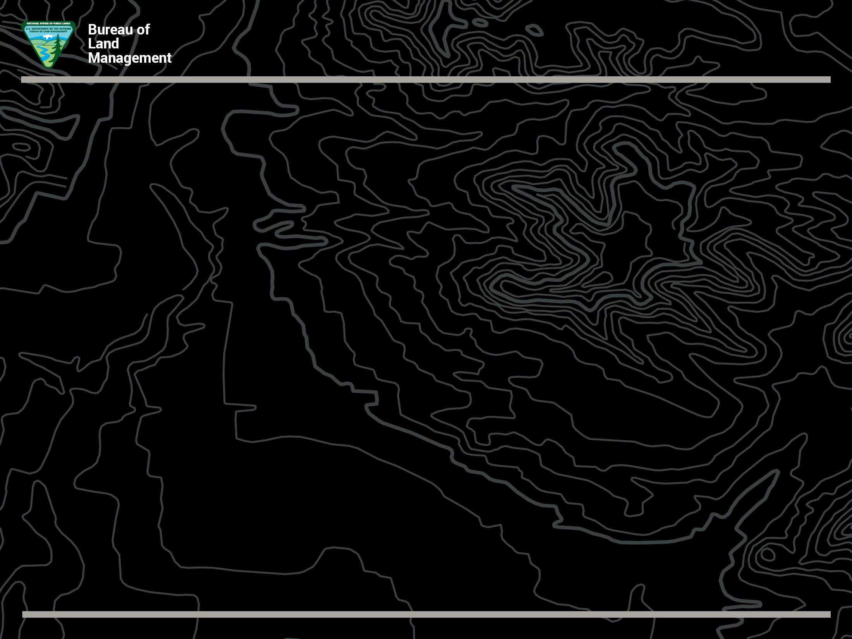
Leon Thomas
District Manager – BLM Phoenix District Office
Rem Hawes
Field Manager – BLM Hassayampa Field Office
Sharing the Trails
National Symposium
November 3, 2018

Slide 2
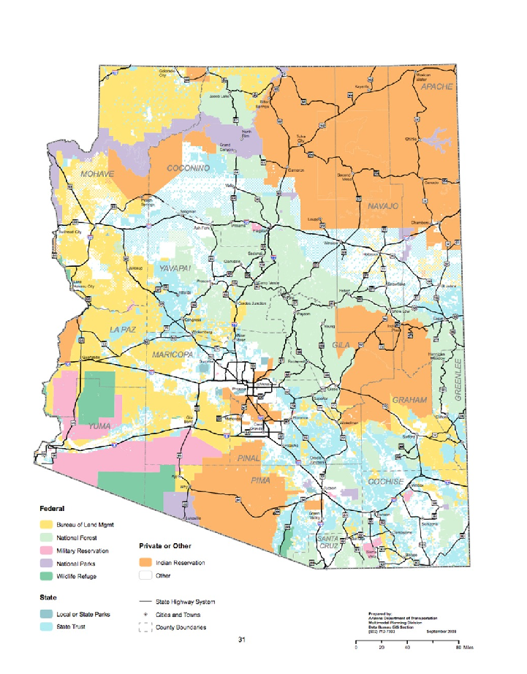
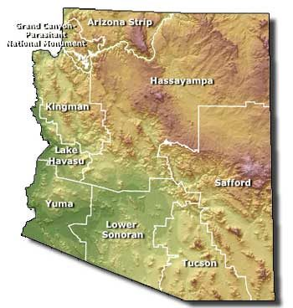
BLM Arizona administers 12.2 million surface acres of public lands, and another 17.5 million subsurface acres within the state, providing a $432 million in economic output.
Notes:
Now that we’ve arrived at the BLM of today, I’d like to drill in a little closer and talk about my state program, BLM Arizona. As you can see on the map on the right, the yellow lands are managed by BLM. The map on the left shows you how districts and field offices are divided. BLM Arizona administers 12.2 million surface acres of public lands, and another 17.5 million subsurface acres within the state.
Phoenix District includes the Hassayampa and Lower Sonoran Field Offices. Gila District includes the Tucson and Safford Field Offices. The Arizona Strip District includes the Arizona Strip District and the Grand Canyon-Parashant National Monument, which we co-manage in a “service first” arrangement with the National Park Service. The Colorado River District includes the Kingman Field Office, Lake Havasu Field Office, and Yuma Field Office.

Slide 3
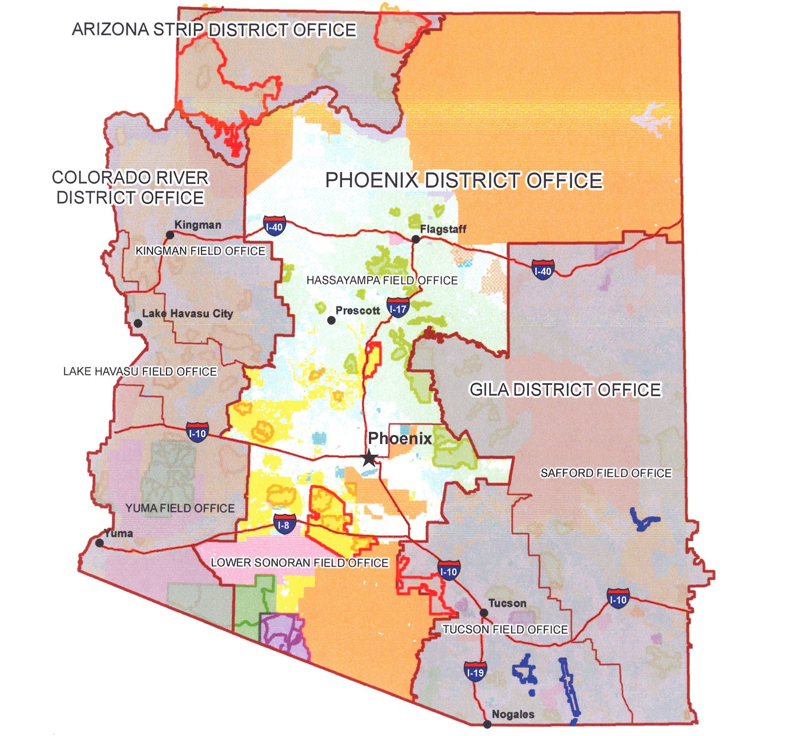
BLM Phoenix District
Notes:
BLM Phoenix District Profile
The Phoenix District manages nearly 2.4 million acres of public lands within seven Arizona counties and administers mineral estate in an additional two counties on the Navajo Indian Reservation. Visitor use has especially increased within the 14 units of the National Conservation Lands that include two national monuments, one national historic trail, 11 wilderness areas, as well as a national recreation trail. From solitary hikes, bike rides, horseback trips, to competitive motorized events, people seek diverse recreational opportunities on public lands that are a short drive from their homes. While there is a soaring demand for recreational opportunities, the District also manages a high volume of major realty actions to accommodate renewable energy and electric transmission projects, natural gas, telecommunications, and mineral processing. Traditional resource management programs in livestock grazing and wild burro herd management continue. With diverse programs in a major Metro area, the District works with minority institutions, such as the Phoenix Union High School District and Phoenix College, to enhance environmental education and recruitment under the Secretary of the Interior’s Order to engage youth through four program elements of Play, Learn, Serve and Work and the First Lady’s initiative Let’s Move Outside.
To better serve the public and meet the growing demands on public lands, the Phoenix District is organized into two field offices – the Hassayampa Field Office, which includes the Agua Fria National Monument, serves population northwest of Phoenix. The Lower Sonoran Field Office, which includes the Sonoran Desert National Monument, manages lands southwest of the city. Additionally, the District manages two wildland fire stations and a regional federal law enforcement communications center for BLM, the National Park Service, U.S. Fish and Wildlife Service, US Forest Service, and Bureau of Indian Affairs.
The Phoenix District excels in community and cooperative interagency partnerships.

Slide 4
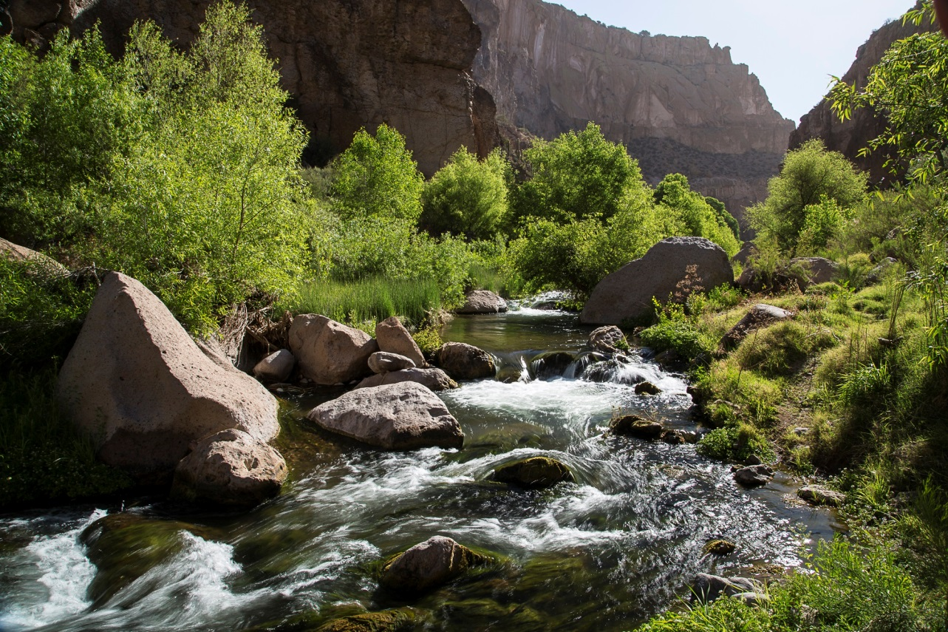
BALANCE POINT:
Managing the health, diversity, & productivity of America's public lands for the use & enjoyment of present & future generations
Notes:
Introduce yourself, tell a little about your background.
The Bureau of Land Management, or BLM, is a small agency with a big mission. Simply put, we manage America’s public lands for the benefit of the American people…today and tomorrow.
Of all the land management agencies, BLM has the most diverse portfolio…Just about everything you encounter on a given day has a nexus to public land…the food on your table, the energy that powers your cars and home, the copper wiring in your cell phone, the roads you drive on, the trails you hike and mountain bike. But with the diverse portfolio come many diverse demands and conflicting opinions on how to manage those resources.
In BLM Arizona, we work to find the balance point between responsible, sustainable use of our public lands and natural resources, in order to make America strong….and also conserving those resources so that they are sustainable for the future.

Slide 5
The Bureau of Land Management was created in 1946, merging the Government Land Office (GLO) and the Grazing Service under one organization.
The BLM and the laws governing our work have evolved over the past 70 years. Today, our mission is to sustain the health, diversity, and productivity of America’s public lands for the use and enjoyment of present and future generations.

Slide 6
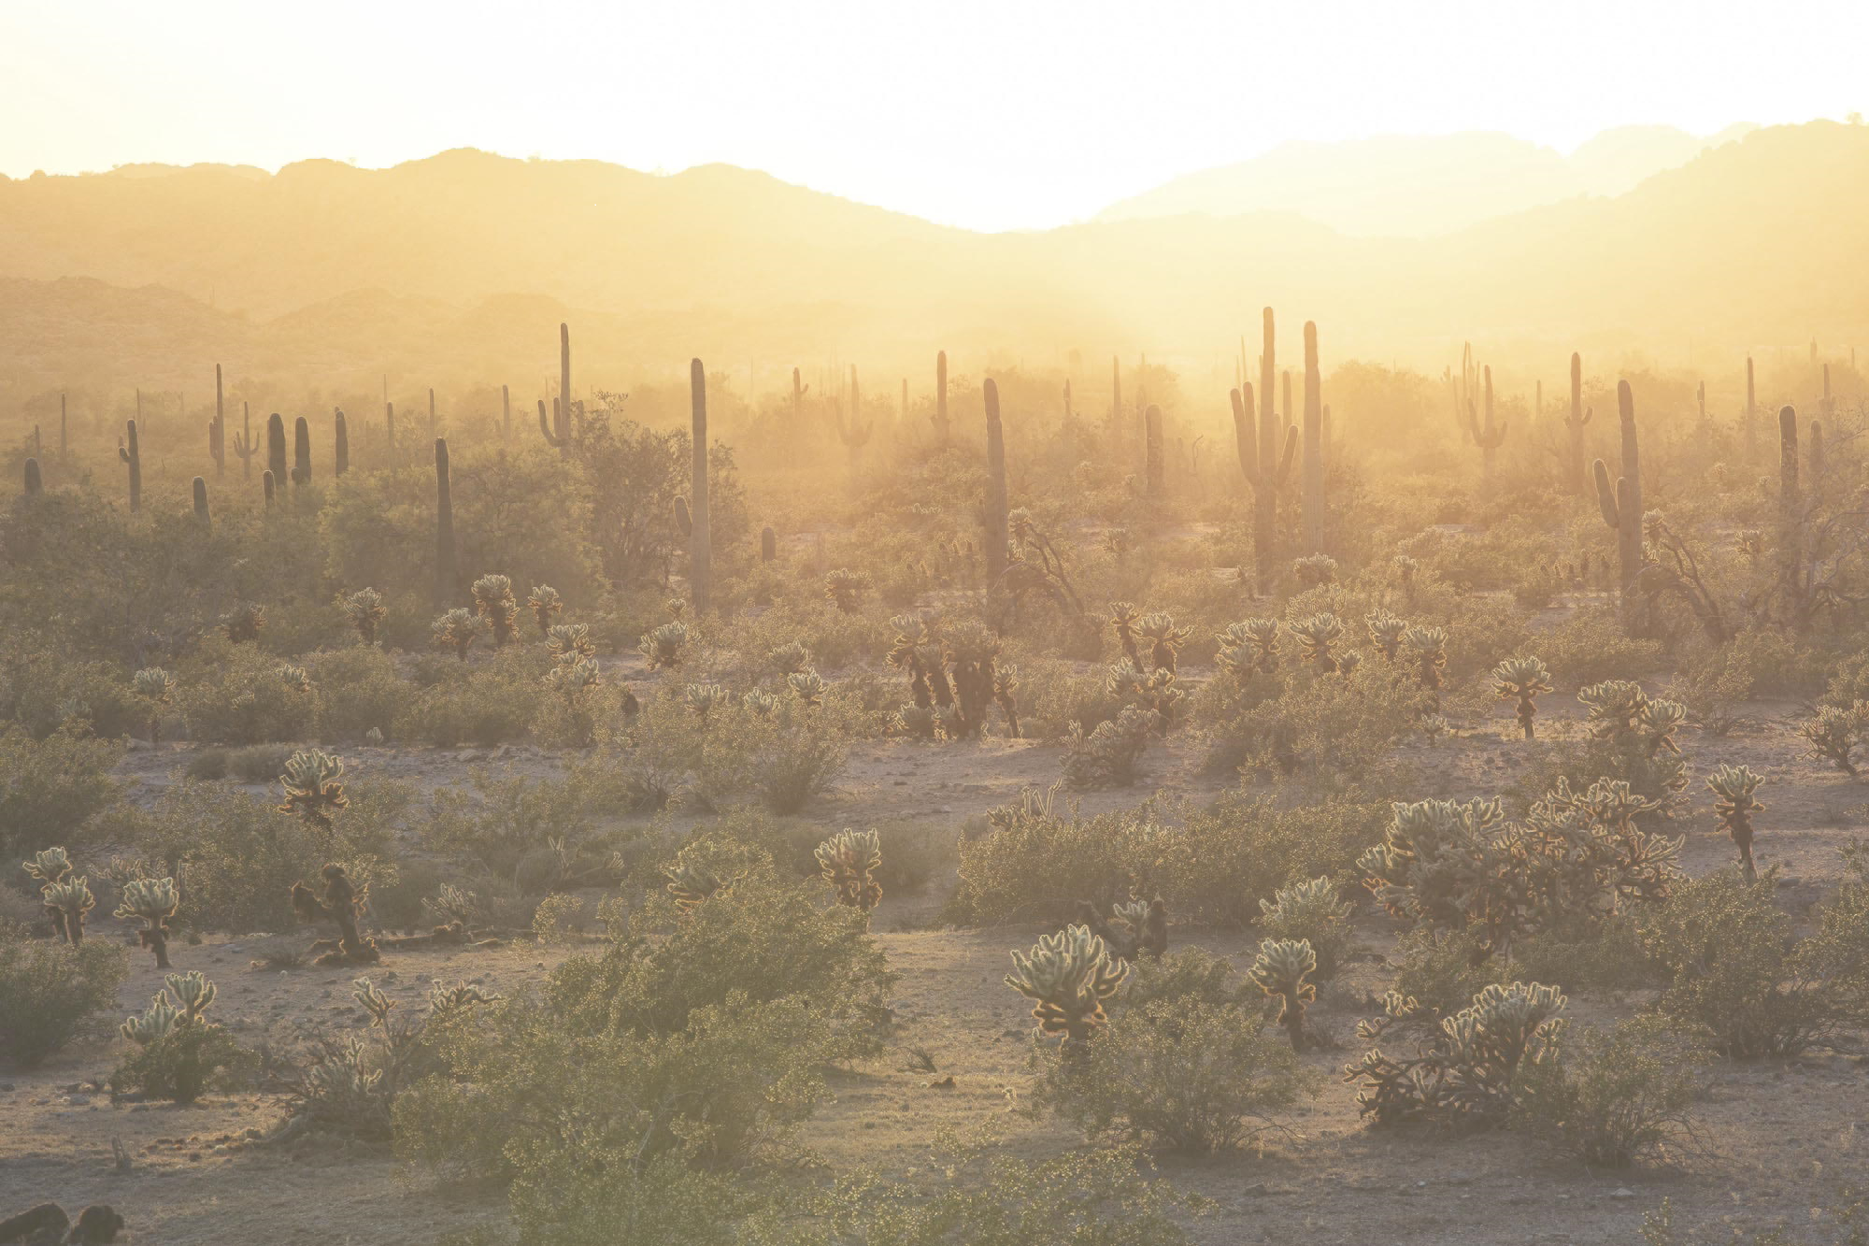
1960s-2000s: Congress passed multiple laws regarding public land management that the BLM follows today:
1964: Wilderness Act
1966: National Historic Preservation Act
1968: Wild & Scenic Rivers Act
1968: National Trails System Act
1970: National Environmental Policy Act
1971: Wild & Free Roaming Horse and Burro Act
1973: Endangered Species Act
1976: Federal Land Policy & Management Act – the BLM organic act
2004: Federal Land Recreation Enhancement Act

Slide 7
Public lands don’t just make America and Arizona beautiful…they make us strong. Sustainable use is at the core of what we do in the BLM. We believe partnership and inclusion are vital to sustainable public lands.
Industries supported by public lands
Ranching
Mining
Energy: solar, wind, oil, gas, coal, transmission
Recreation
Tourism
Construction
Transportation
Entertainment

Slide 8
Recreation on Public Lands
The BLM's recreation resources support strong local economies and public land conservation. As we work to enhance recreational opportunities for the American family, we strive to remain a good neighbor. This means respecting how communities use the public lands, as well as including their voices in our management decisions.

Slide 9
Recreation on Public Lands
Stay on existing roads and trails — all users.
Cross-country travel — allowed for hikers and equestrians, however avoid causing new trails to develop.
Obey signs and maps.

Slide 10
Travel Management
In the 1980s, in response to Presidential Executive Orders 11644 and 1989, the BLM began to address public concerns regarding the proliferation of unplanned roads and trails and their impact on public land resources and uses. This involved designating all public lands as either “open,” “limited,” or “closed” to off-highway vehicle (OHV) use

Slide 11
Route Designations
Analyze existing routes and designate them as “open,” “limited,” or “closed.”
Provide implementation details (maintenance, signing, enforcement etc.) for how a travel network would be managed on the ground.

Slide 12
Travel Management Plans:
Agua Fria National Monument
Table Mesa Recreation Area
Wickenburg
Black Canyon Corridor

Slide 13
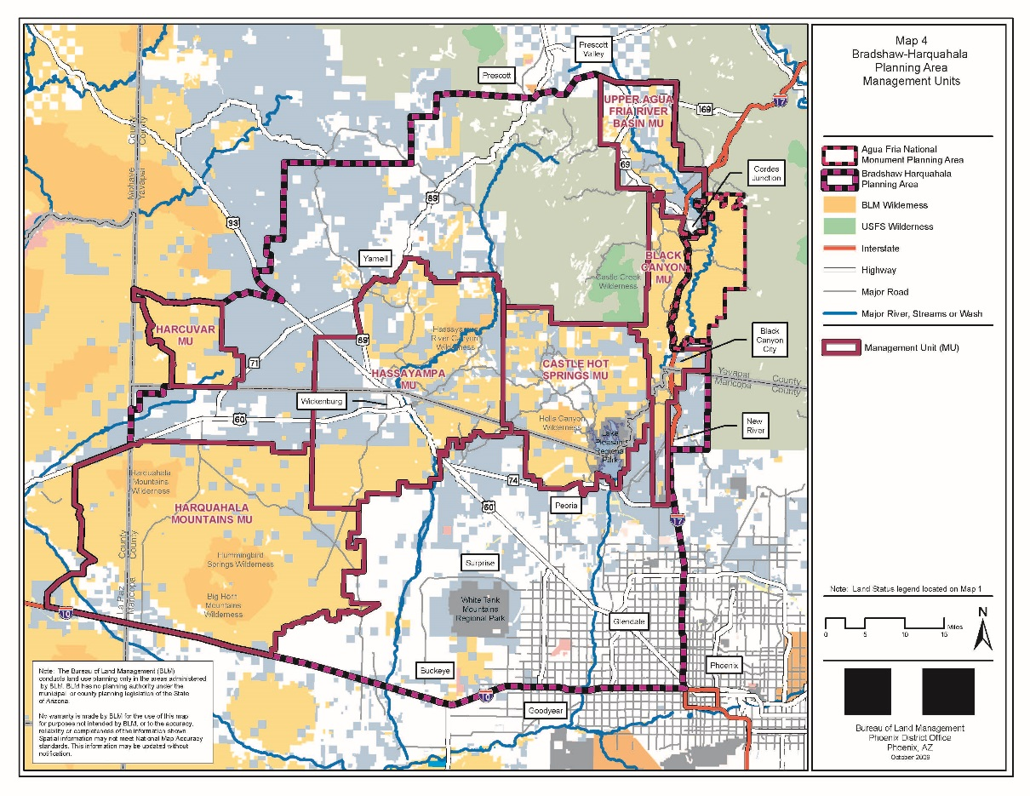
Black Canyon Corridor Travel Management Plan

Slide 14
Black Canyon Plan Objectives:
Accommodate diverse land uses while protecting natural and cultural values and prior rights.
Plan Scope:
Implement a system of roads and trails on BLM land
Guidance for route system and Black Canyon National Recreation Trail
Identify trail related facilities needed and desired amenities
Creation of a plan for implementation

Slide 15
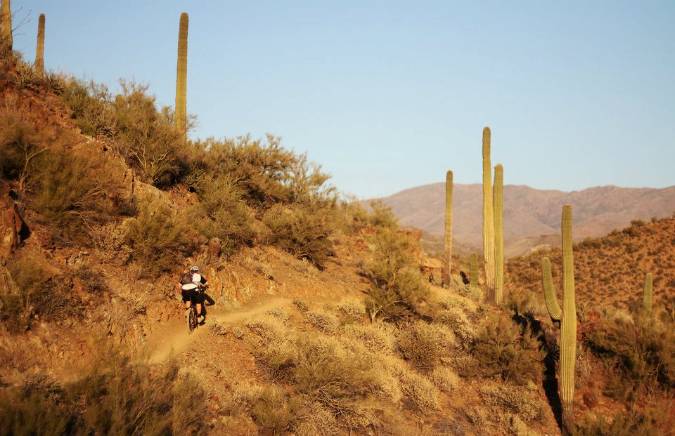
Black Canyon National Recreation Trail

Slide 16
Black Canyon National Recreation Trail
2008 — Designated a National Recreation Trail.
2012 — Bicycling Magazine ranked the Trail the best ride in Arizona.
2014 — International Mountain Biking Association (IMBA) ranked it the best mountain biking trail in the Arizona.
2015 — IMBA selected the Trail as one of the “Top 20 Mountain Bike Opportunities" in nation.
2015 — Was a National Public Lands Day site.
Notes:
The Black Canyon National Recreation Trail is the 80-mile trail which stretches from Phoenix to within 40 miles of Prescott, and features hiking, mountain biking, and horse riding. The trail was originally established as a livestock driveway. Many segments of the trail roughly parallel the old Black Canyon stagecoach road between Phoenix and Prescott. Today — BLM is committed to working with partners, the Black Canyon Trail Coalition and communities to improve and maintain the Trail benefit communities and the public lands.

Slide 17
Special Recreation Permits (SRPs)
Determine land use plan conformance.
Determine if a SRP is required.
Is the activity commercial in nature?
Is the activity competitive?
Is a vending permit necessary and appropriate?
Is an organized group permit required?

Slide 18
Why Form Partnerships?
Budget cuts have drastically cut funding. New projects and maintenance have been dropped or cut back.
Partnerships can bring much needed labor, and in some cases dollars to bridge this gap.
Without partnerships, land resources degrade and many recreation activities could be lost or severely cut back.
Partnerships help build bonds and friendships where “us versus them” may have existed before.
Gives a better sense of ownership and pride in recreation.

Slide 19
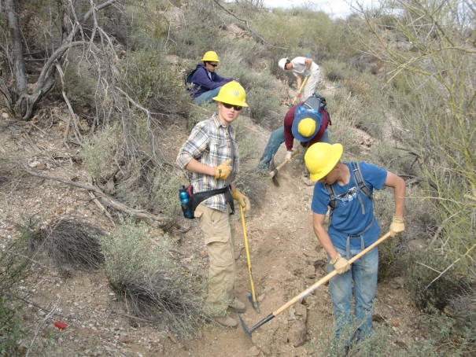
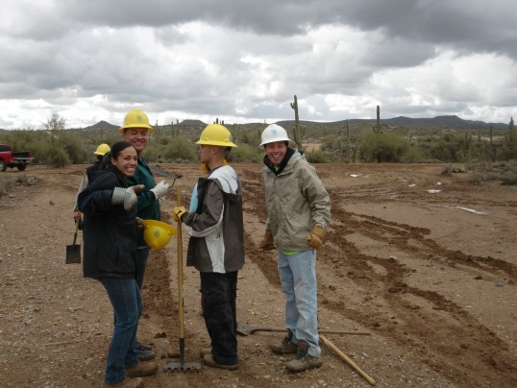
BLM Partnership & Volunteer Projects
Private property access for OHV/multi-use trail connection across private property. OHV group, BLM, and AZ Game and Fish working together.
Solutions: Partnered with Game and Fish for access agreement not possible thru BLM alone.
Trail maintenance and rehab project with SCA

Slide 20
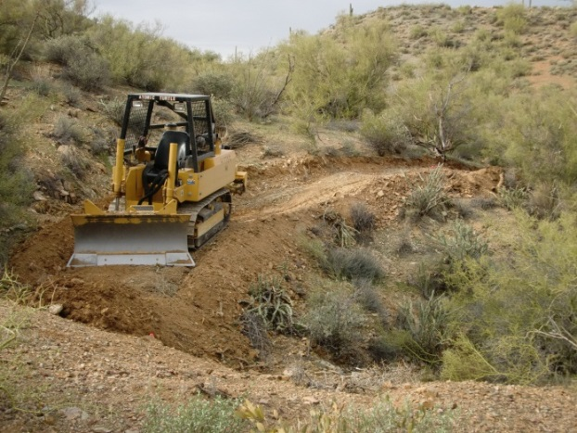
BLM Partnership Projects
New trail construction to replace CLOSED River bottom route. Bronco Club volunteers and AZOHVC trail project.
OHV Decal Grant Fund
Solutions: BLM travel plan closed river corridor, work on new BLM bypass trail gave alternative to loss and group took ownership in their work on new trail. Adopt a trail program.

Slide 21
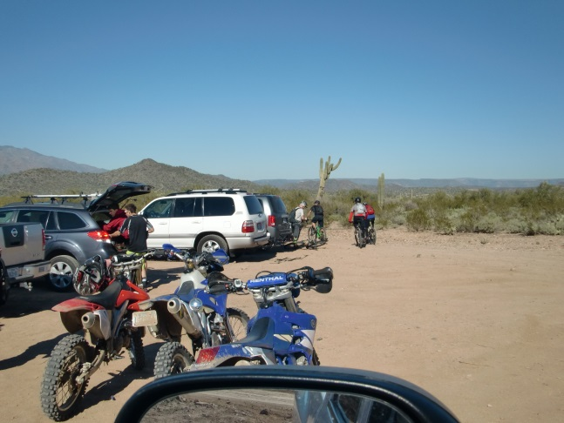
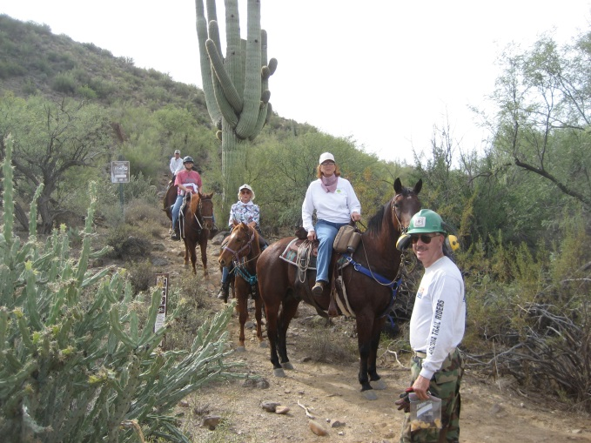
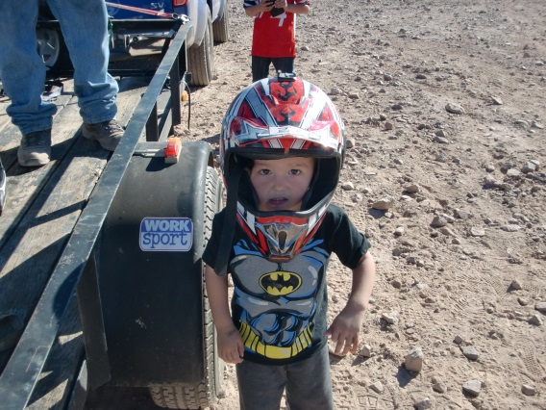
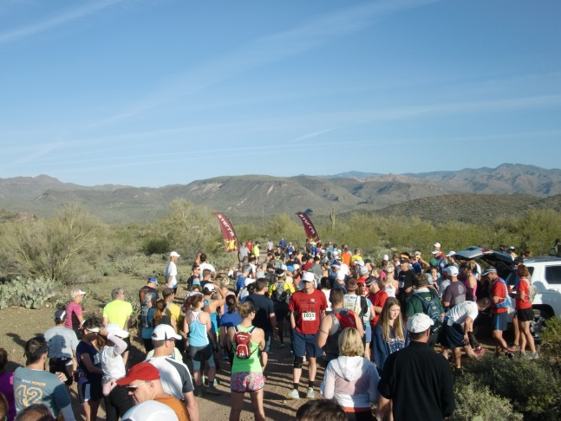
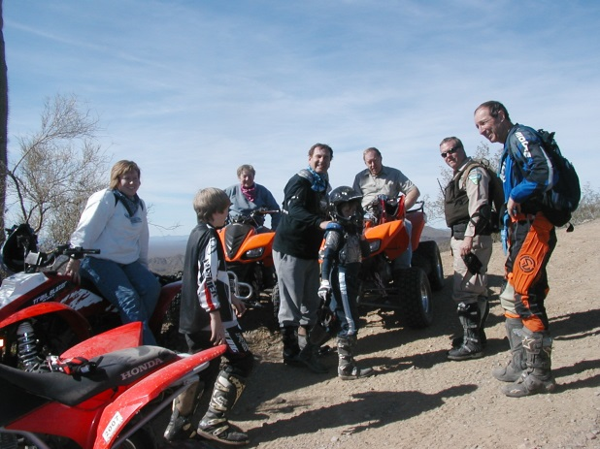
Agency Management of Recreation and Resources
BLM manages for all these uses and more…….HOW CAN YOU HELP?
You can’t have all things in all places, but you have to have a place for everything!

Slide 22
BLM Phoenix District Office – Contacts
Leon Thomas, District Manager
Phoenix District Office
623-580-5600
Rem Hawes, Field Manager Mariela Castaneda
Hassayampa Field Office Public Affairs
Phoenix District Phoenix District Office
623-580-5530 623-580-5520

